Slide 1

COMP 520 - Compilers
Lecture 15 – PA4 Details

Slide 2
Midterm 2 Postponed to 4/11
WA3 is out
  Quick questions on REX bit flags, stack framing, and x64
PA3 – If you haven’t submitted yet, make sure to submit to Partial only. Your first submission to the “Full” tests will be your grade, minus a late penalty.
COMP 520: Compilers – S. Ali

Slide 3
Midterm 2
Cumulative
Know your:
  Identification
  Type-Checking
  Visitor Traversal
  Assembly Generation
COMP 520: Compilers – S. Ali

Slide 4
PA4 – A Unique Opportunity
Have the ability to claim that you wrote a REAL compiler.
COMP 520: Compilers – S. Ali

Slide 5
PA4 – A Unique Opportunity
Have the ability to claim that you wrote a REAL compiler.
Starter code does the mundane parts of code generation (make sure bytes are in the right order, make sure you can set the REX prefix after-the-fact).
COMP 520: Compilers – S. Ali

Slide 6
Course Registration Open
For our seniors: Show them what UNC students are capable of. You wrote an x64 compiler, a feat not many are capable of.
COMP 520: Compilers – S. Ali

Slide 7
Course Registration Open
For our seniors: Show them what UNC students are capable of. You wrote an x64 compiler, a feat not many are capable of.
For those who will continue with their coursework: if you didn’t let this class beat you, there shouldn’t be any other class that can. Treat each as a challenge.
COMP 520: Compilers – S. Ali

Slide 8
Highly Suggested Courses
COMP 750- Grad Algorithms. An essential course if you want to call yourself a computer scientist. Difficult, but you will look back on it fondly.
COMP 630/541. Get to write an OS / get to construct a processor, nearly from scratch.
COMP 520: Compilers – S. Ali

Slide 9
Let’s get coding!
COMP 520: Compilers – S. Ali

Slide 10
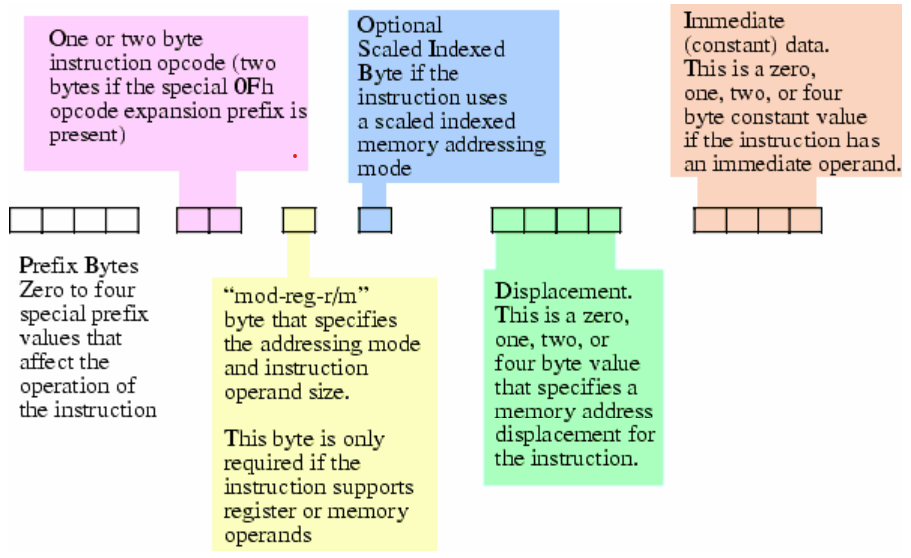
Instruction Encoding (c-jump.com)
COMP 520: Compilers – S. Ali

Slide 11
Quick Review of ModRM/SIB
ModRM: http://ref.x86asm.net/coder64.html#modrm_byte_32_64
SIB: http://ref.x86asm.net/coder64.html#sib_byte_32_64
COMP 520: Compilers – S. Ali

Slide 12
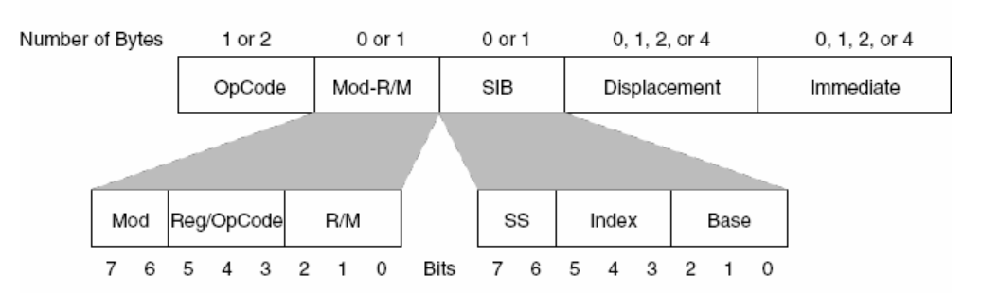
Instruction Encoding (c-jump.com)
STEP ONE
COMP 520: Compilers – S. Ali

Slide 13
Mod RM
Used to allow operands: rm, r or [rdisp+disp],r
Register operands are encoded in the ModRM byte.
COMP 520: Compilers – S. Ali

Slide 14
Mod RM (2)
Used to allow operands: rm, r or [rdisp+disp],r
Register operands are encoded in this byte.
Do you have plain registers?
  Yes: mod=11
  No: mod=??
COMP 520: Compilers – S. Ali

Slide 15
Mod RM (3)
Memory operation, like [rdisp+disp]
Do you have a zero displacement?
  Mod=00
Do you have a 1-byte displacement?
  Mod=01
4-byte displacement?
  Mod=10
COMP 520: Compilers – S. Ali

Slide 16
01 010 110
Mod Value
“R” Index
“Rdisp” Index
COMP 520: Compilers – S. Ali

Slide 17
01 010 110
Mod Value
=1 byte disp
“R” Index
RDX=2
“Rdisp” Index
RSI=6
COMP 520: Compilers – S. Ali

Slide 18
Combined: [rsi+XX],rdx
01 010 110
Mod Value
=1 byte disp
“R” Index
RDX=2
“Rdisp” Index
RSI=6
COMP 520: Compilers – S. Ali

Slide 19
Combined: [rsi+XXYYZZWW],rdx
10 010 110
Mod Value
=4 byte disp
“R” Index
RDX=2
“Rdisp” Index
RSI=6
COMP 520: Compilers – S. Ali

Slide 20
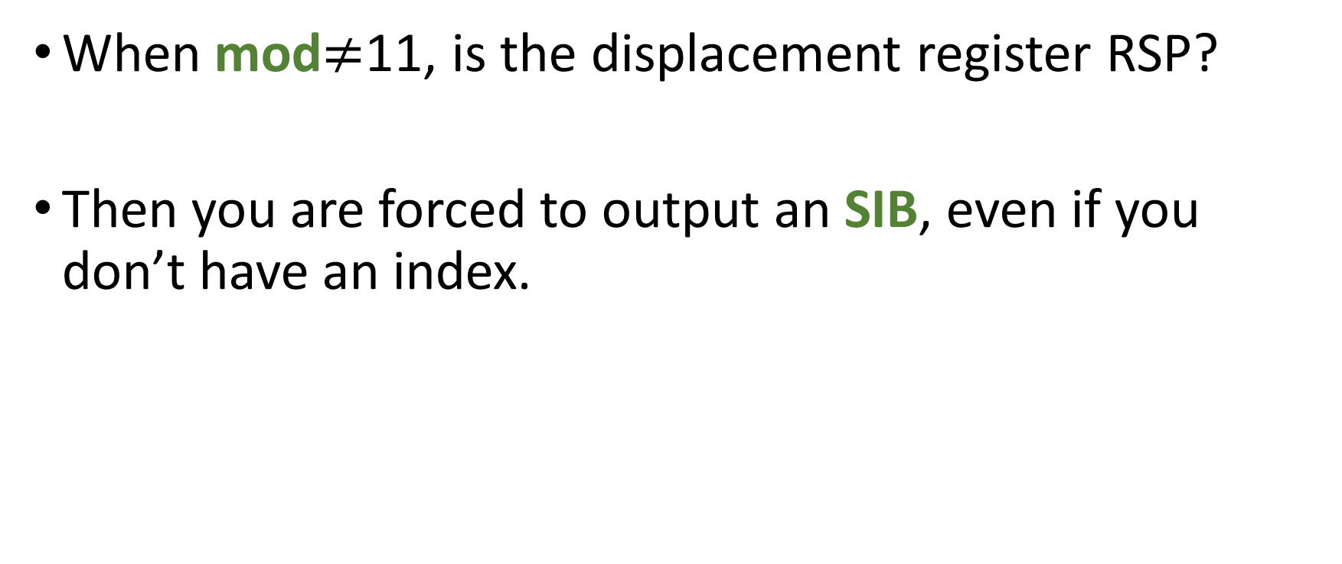
ModRM
When mod$≠$11, is the displacement register RSP?
Then you are forced to output an SIB, even if you don’t have an index.
COMP 520: Compilers – S. Ali

Slide 21
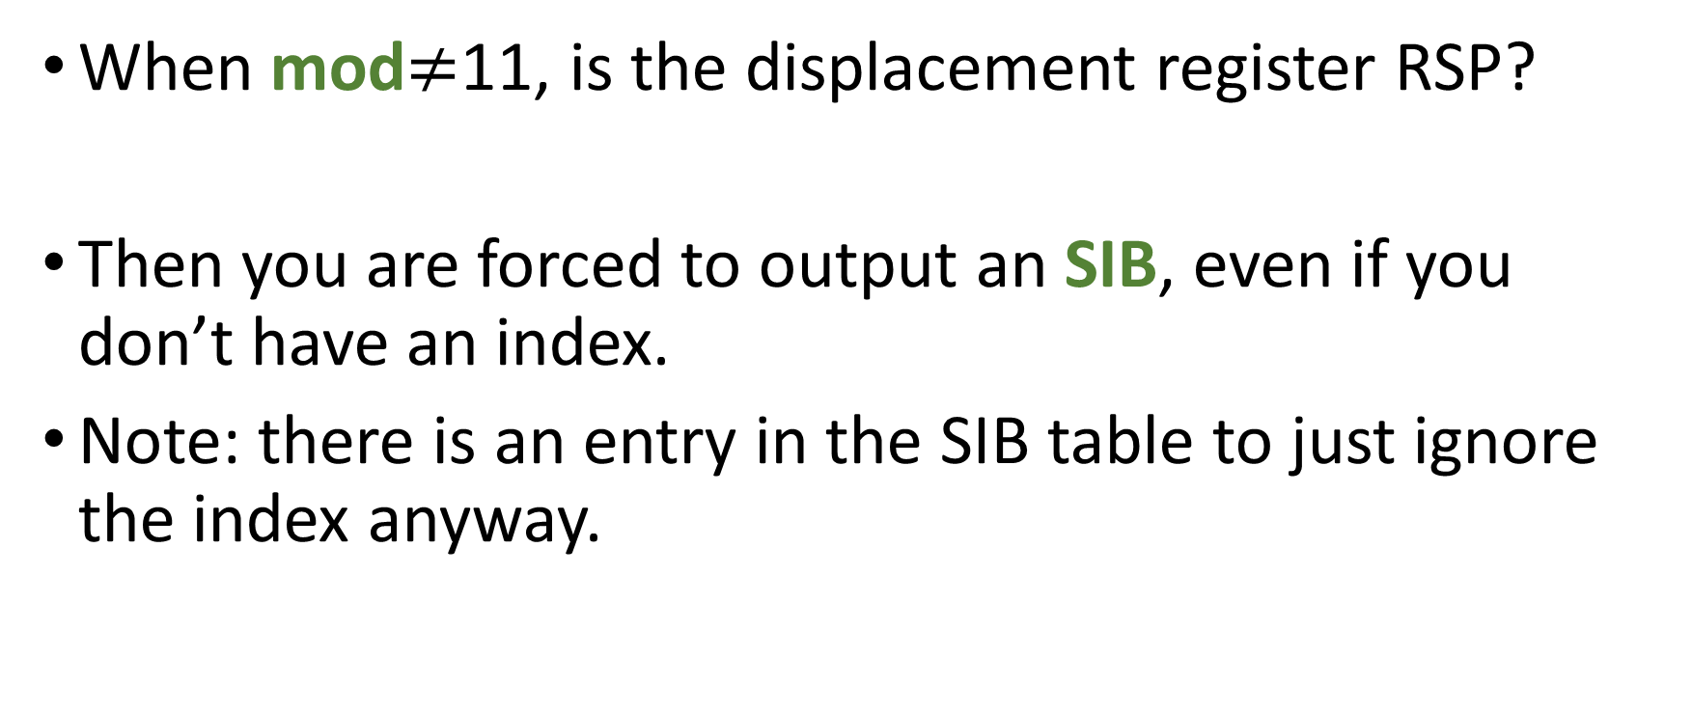
ModRM
When mod$≠$11, is the displacement register RSP?
Then you are forced to output an SIB, even if you don’t have an index.
Note: there is an entry in the SIB table to just ignore the index anyway.
COMP 520: Compilers – S. Ali

Slide 22
Instruction Encoding (c-jump.com)
STEP TWO
COMP 520: Compilers – S. Ali

Slide 23
Scaled Index Byte: ridx*mult
Is your index multiplier x1, x2, x4, x8?
  Then, ss= 00, 01, 10, 11 respectively
Note, for SIB, a displacement register has not yet been picked.
SIB forces the ModRM “rdisp” register to be RSP
COMP 520: Compilers – S. Ali

Slide 24
Combined: [rsi+rcx*2+XX],r
01 001 110
SS Value
=multiply by 2
“RIDX” Index
RCX=1
“RDISP” Index
RSI=6
COMP 520: Compilers – S. Ali

Slide 25
Take care for exceptions
Note, RSP cannot be used as an index register.
Question: what other intricacies are there, and why?
COMP 520: Compilers – S. Ali

Slide 26
Take care for exceptions
Note, RSP cannot be used as an index register.
Question: what other intricacies are there, and why?
If getting stuck, it may be useful to draw out a decision tree.
COMP 520: Compilers – S. Ali

Slide 27
PA4 x64 Code Generation
COMP 520: Compilers – S. Ali

Slide 28
Step 1: Finish ModRMSIB Class
There is starter code on the course website.
The ModRMSIB class decides which registers are used in an instruction (it doesn’t care about order, but just the operands themselves).
COMP 520: Compilers – S. Ali

Slide 29
Step 1: Finish ModRMSIB Class
There is starter code on the course website.
The ModRMSIB class decides which registers are used in an instruction (it doesn’t care about order, but just the operands themselves).
The “Make” methods need to be completed. An example for “rm,r” is done.
COMP 520: Compilers – S. Ali

Slide 30
ModRMSIB Strategy
Test instances of this class.
Output the bytes, and make sure your implementation matches what is on the table.
COMP 520: Compilers – S. Ali

Slide 31
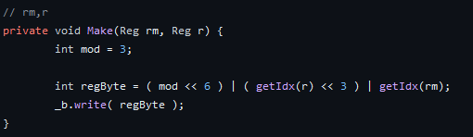
Make Methods: rm, r
COMP 520: Compilers – S. Ali

Slide 32
Make: [rdisp+disp],r
Implement this inside:
private void Make(
Reg64 rdisp, int disp, Reg r
)
COMP 520: Compilers – S. Ali

Slide 33
Make: [ridx*mult+disp],r
Implement this inside:
private void Make(
Reg64 ridx, int mult, int disp, Reg r
)
COMP 520: Compilers – S. Ali

Slide 34
Make: [rdisp+ridx*mult+disp],r
Implement this inside:
private void Make(
Reg64 rdisp, Reg64 ridx, int mult, int disp, Reg r
)
COMP 520: Compilers – S. Ali

Slide 35
Once you have encoded the table in these methods…
You are done with the most difficult part of encoding assembly into bytecode.
The operands are the hardest part, and the rest is material you have seen before.
COMP 520: Compilers – S. Ali

Slide 36
Once you have encoded the table in these methods…
You are done with the most difficult part of encoding assembly into bytecode.
The operands are the hardest part, and the rest is material you have seen before.
Opcodes get some bytes, Prefixes get some bytes, and immediates get some bytes.
COMP 520: Compilers – S. Ali

Slide 37
Unsure about how something is encoded?
Check the tool: https://defuse.ca/online-x86-assembler.htm#disassembly2
Test things such as “mov r11,[r10+r8*8+2222]” to make sure your implementation gets the correct ModRM and SIB bytes
COMP 520: Compilers – S. Ali

Slide 38
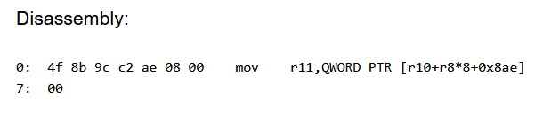
Unsure about how something is encoded?
Check the tool: https://defuse.ca/online-x86-assembler.htm#disassembly2
Test things such as “mov r11,[r10+r8*8+2222]” to make sure your implementation gets the correct ModRM and SIB bytes
COMP 520: Compilers – S. Ali

Slide 39
Code Generation and Visitor Traversal
COMP 520: Compilers – S. Ali

Slide 40
Instruction
Instruction is an abstract class that has some associated bytecode with it.
Includes prefix bytes, immediate bytes, …
All of these:
COMP 520: Compilers – S. Ali

Slide 41
Instruction (2)
The first instruction has a start address of zero.
…
The next instruction has a start address of the previous instruction start address + size.
COMP 520: Compilers – S. Ali

Slide 42
Instruction List
A list of instructions with a few extra items.
If you add an Instruction to an InstructionList, it will populate the startAddress and listIdx fields.
(Where listIdx is the index of the instruction, e.g., the 0th instruction has a listIdx of 0).
COMP 520: Compilers – S. Ali

Slide 43
Instruction Implementations
Several files in the starter code are marked with TODOs.
Find these and implement them just like with ModRMSIB.
COMP 520: Compilers – S. Ali

Slide 44
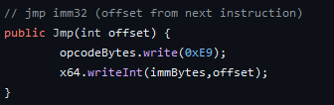
Example: JMP Imm32
Consider unconditional jump: jmp imm32
In our instruction list, find it, opcode 0xE9.
COMP 520: Compilers – S. Ali

Slide 45
Example: JMP Imm32
Consider unconditional jump: jmp imm32
In our instruction list, find it, opcode 0xE9.
Then implement it:
Take notes: the imm32
is an offset from the
start of the next ins.
COMP 520: Compilers – S. Ali

Slide 46
Read other implementations as well!
IDIV: Divide RDX:RAX / rm
RDX: 00000001, RAX: 00000001
COMP 520: Compilers – S. Ali

Slide 47
Read other implementations as well!
IDIV: Divide RDX:RAX / rm
RDX: 00000001, RAX: 00000001
Thus, the operand becomes:
  4294967297 / rm
E.g.: 4294967297 / [rbp-16]
COMP 520: Compilers – S. Ali

Slide 48
Operands created with ModRMSIB
How can we actually generate x64?
COMP 520: Compilers – S. Ali

Slide 49
Operands created with ModRMSIB
new Push(new ModRMSIB(Reg64.RBP,16)
);
Analogous to:
push [rbp+16]
COMP 520: Compilers – S. Ali

Slide 50
Operands created with ModRMSIB
new Push(new ModRMSIB(Reg64.RBP,16)
);
new Mov_rrm(new ModRMSIB(
Reg64.RSI,Reg64.RCX,4,0x1000,Reg64.RDX
);
Analogous to:
push [rbp+16]
mov rdx, [rsi+rcx*4+0x1000]
COMP 520: Compilers – S. Ali

Slide 51
Operands created with ModRMSIB
new Push(new ModRMSIB(Reg64.RBP,16)
);
new Mov_rrm(new ModRMSIB(
Reg64.RSI,Reg64.RCX,4,0x1000,Reg64.RDX
);
Analogous to:
push [rbp+16]
mov rdx, [rsi+rcx*4+0x1000]
R operand, then RM operand (so move from memory to register)
COMP 520: Compilers – S. Ali

Slide 52
mov rm,r
Don’t always need to dereference memory locations.
Mov_rmr can also take a plain:
new ModRMSIB( Reg64.RCX, Reg64.RDX )
Results in: mov rcx,rdx
COMP 520: Compilers – S. Ali

Slide 53
AST Decoration
COMP 520: Compilers – S. Ali

Slide 54
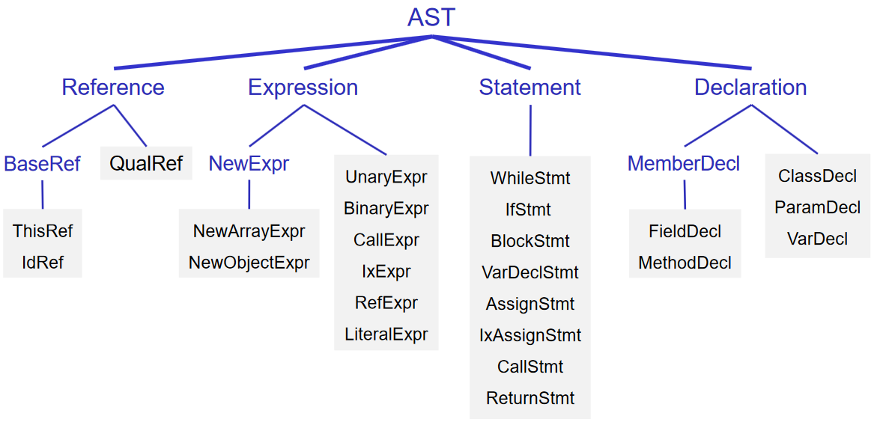
Identifiers get updated with
a “decl” object
COMP 520: Compilers – S. Ali

Slide 55
This is now a decorated AST
Identifiers get updated with
a “decl” object
COMP 520: Compilers – S. Ali

Slide 56
We need additional decorations
Where is a variable in memory?
Let’s store that in the AST!
We will need a point(er) of reference, and map out our memory appropriately.
We call this data the “RuntimeEntity” object, for each variable.
COMP 520: Compilers – S. Ali

Slide 57
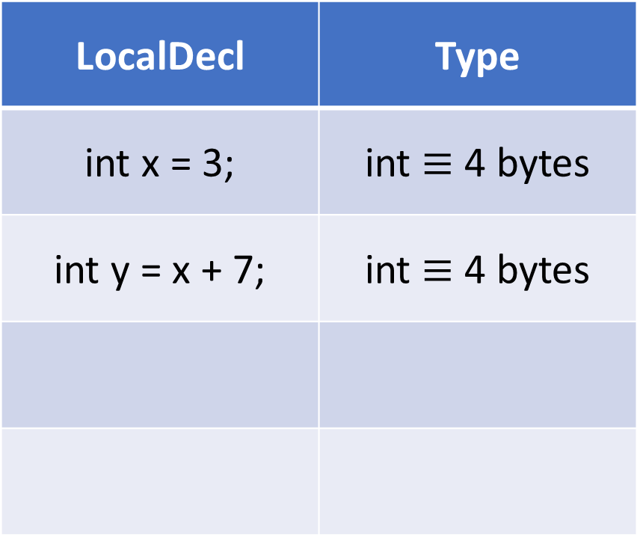
Runtime Entity
LocalDecl | Type
int x = 3; | int $≡$ 4 bytes
int y = x + 7; | int $≡$ 4 bytes
Reference | Offset
rbp | -8
rbp | -16 ???
COMP 520: Compilers – S. Ali

Slide 58
Stack
Push and Pop always operate 64-bits at a time
This is because we are in 64-bit mode (long mode)
Thus, storing data on the stack will always be 8 bytes long.
COMP 520: Compilers – S. Ali

Slide 59
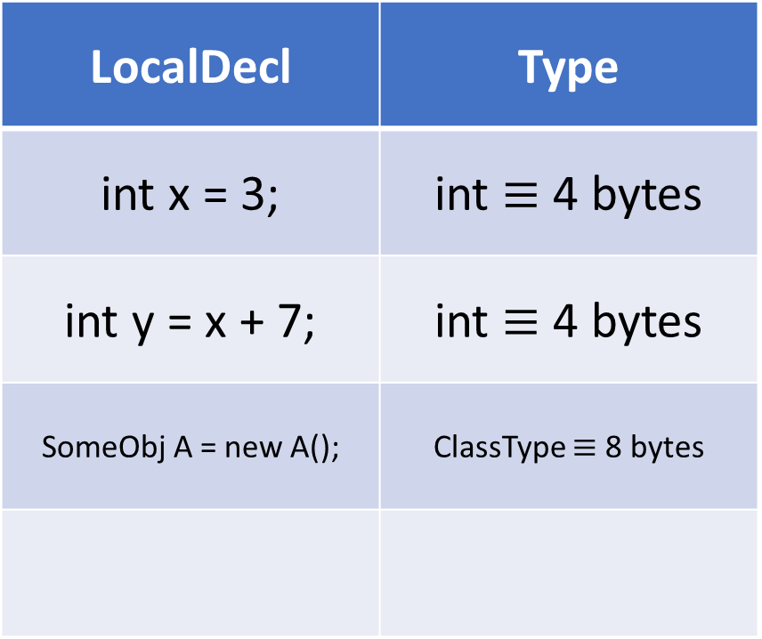
Runtime Entity
LocalDecl | Type
int x = 3; | int $≡$ 4 bytes
int y = x + 7; | int $≡$ 4 bytes
SomeObj A = new A(); | ClassType $≡$ 8 bytes
Reference | Offset | Code
rbp | -8 | push 0 ??
rbp | -16 | push 0 ??
rbp | -24 | push 0 ??
COMP 520: Compilers – S. Ali

Slide 60
Push
We will create space on the stack by initializing data to zero.
Push will decrement RSP by 8, THEN store the data being pushed
After evaluating the expression, store something in the appropriate location.
COMP 520: Compilers – S. Ali

Slide 61
Static Variables
We are targeting position-independent code
This means that .bss is not easy to resolve.
In PA5- optional extra credit to properly implement .bss
For PA4- where can we store static data? (Note, if it stays on the stack, doesn’t have to be 8 bytes)
COMP 520: Compilers – S. Ali

Slide 62
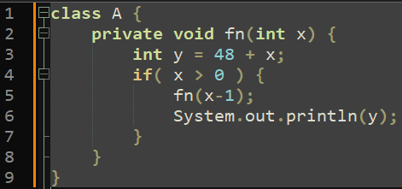
What about recursion?
Consider:
Every call of this
function needs a
separate location
for the local variable y and parameter x
COMP 520: Compilers – S. Ali

Slide 63
Stack Frame
Every function call, move up your point of reference (which can be RBP or RSP).
COMP 520: Compilers – S. Ali

Slide 64
Stack Frame
Every function call, move up your point of reference (which can be RBP or RSP).
Consider a static method: fn(x)
x | [return addr] | ?? | ?? | ??
RSP+8
RSP-8
RSP-16
RSP
When method starts
COMP 520: Compilers – S. Ali

Slide 65
Stack Frame
Consider after local variables declared:
New Local about to be declared
x | [return addr] | Old RBP | Local var1 | ??
RBP+16
RSP+24
RBP+8
RSP+16
RBP
RSP+8
RBP-8
RSP
RBP-16
RSP-8
COMP 520: Compilers – S. Ali

Slide 66
Stack Frame
Consider after local variables declared:
Thus, easier to reference data from rbp (assuming you set up your stack frame correctly)
x | [return addr] | Old RBP | Local var1 | Local var2
RBP+16
RSP+32
RBP+8
RSP+24
RBP
RSP+16
RBP-8
RSP+8
RBP-16
RSP
COMP 520: Compilers – S. Ali

Slide 67
Member Variables (FieldDecl)
Where are field variables?
First, let’s figure out the size of a class.
COMP 520: Compilers – S. Ali

Slide 68
Member Variables (FieldDecl)
Where are field variables?
First, let’s figure out the size of a class.
Objects should be allocated on the heap. Meaning their data should not be on the stack.
Instead, an object is just an 8 byte pointer
COMP 520: Compilers – S. Ali

Slide 69
Map out the data
FieldDecl | Runtime Entity | Size | ASM
int x | Base + 0 | 4 | dword [r+0]
int y | Base + 4 | 4 | dword [r+4]
A z | Base + 8 | 8 | qword [r+8]
COMP 520: Compilers – S. Ali

Slide 70
How was the data allocated?
push 0 call mmap mov [rbp-8],rax ?? | A a = new a(); a.y = 3;
COMP 520: Compilers – S. Ali

Slide 71
How was the data allocated?
push 0 call mmap mov [rbp-8],rax mov rsi,[rbp-8] mov [rsi+4],3 | A a = new a(); a.y = 3;
COMP 520: Compilers – S. Ali

Slide 72
FieldDecl
Thus, the runtime entity for a FieldDecl is, once again, some offset
The base address can be loaded during runtime (unlike being an offset from RBP)
COMP 520: Compilers – S. Ali

Slide 73
What about this.x?
What if we are in an instance method?
Where is the “current object: this”?
COMP 520: Compilers – S. Ali

Slide 74
Instance Methods
SomeClass.myStaticMethod(x) – pretty normal
a.nonStaticMethod(x,y) – slightly different
COMP 520: Compilers – S. Ali

Slide 75
Stack Frame
a.nonStaticMethod(x,y) – Hidden “this” parameter
Will be used to find FieldDecl variables in the current object instance.
y | x | this | [return] | Old rbp | ??
RBP+32
RSP+32
RBP+24
RSP+24
RBP+16
RSP+16
RBP+8
RSP+8
RBP
RSP
COMP 520: Compilers – S. Ali

Slide 76
System.out.println
Recall for PA4, miniJava is incomplete because String has not yet been implemented (optional for PA5)
We take in a parameter, and need to output it on the screen
COMP 520: Compilers – S. Ali

Slide 77
System Calls
We will be using the SYS_write system call to output data to the console.
Where fd=stdout=1
COMP 520: Compilers – S. Ali

Slide 78
Read the mmap system call in starter files
Find out how sys_write is called, it is very similar to sys_mmap
Implement sys_write where the int parameter to System.out.println(int n) is the output byte.
The printable character ‘0’ is 48, take care for this when testing.
COMP 520: Compilers – S. Ali

Slide 79
System.out.println
Outputs one byte (null terminated, so two bytes)
Do not output a line break (can do this in PA5)
System.out.println(53)
System.out.println(50)
System.out.println(48)
What will this output? Consult a hex-ascii table.
COMP 520: Compilers – S. Ali

Slide 80
Actual Code Generation Step
COMP 520: Compilers – S. Ali

Slide 81
Case study: Flat Assembler
A very simple assembler, outputs x86_64 bytecode
It compiles the code 3 times (known as passes)
Only then does it reach “optimization level zero”
COMP 520: Compilers – S. Ali

Slide 82
Quick Note: Optimization Level
Compilers can optimize your code by rewriting it efficiently (restructuring your ASTs is one method)
-O0 (letter O, number zero) does no optimization
COMP 520: Compilers – S. Ali

Slide 83
Quick Note: Optimization Level
Compilers can optimize your code by rewriting it efficiently (restructuring your ASTs is one method)
-O0 (letter O, number zero) does no optimization
We do not require multiple passes to reach level 0, you can instead output inefficient “less than O0” code
COMP 520: Compilers – S. Ali

Slide 84
Strategy: Stack-based evaluation
Everything should be evaluated on the stack, and loaded into registers for only short code portions
COMP 520: Compilers – S. Ali

Slide 85
Goal: Expressions
Evaluate: 3+4*5-6
COMP 520: Compilers – S. Ali

Slide 86
Goal: Expressions
Evaluate: 3+4*5
visitBinExpr: (visit LHS, visit RHS expressions)
COMP 520: Compilers – S. Ali

Slide 87
Goal: Expressions
Stack
3
Evaluate: 3+4*5
visitBinExpr: (visit LHS, visit RHS expressions)
  LHS: visitLiteralExpr: push 3
  RHS: visitBinExpr: ?
COMP 520: Compilers – S. Ali

Slide 88
Goal: Expressions
Stack
5
4
3
Evaluate: 4*5
visitBinExpr: (visit LHS, visit RHS expressions)
  LHS: visitLiteralExpr: push 4
  RHS: visitBinExpr: push 5
COMP 520: Compilers – S. Ali

Slide 89
Goal: Expressions
Stack
5 -> X
4 -> X
3
Evaluate: 4*5
visitBinExpr: (visit LHS, visit RHS expressions)
  LHS: visitLiteralExpr: push 4
  RHS: visitBinExpr: push 5
Operator is multiply:
  pop rcx, pop rax # Get two operands
Registers
rax | 4
rcx | 5
COMP 520: Compilers – S. Ali

Slide 90
Goal: Expressions
Stack
-
-
-
3
Evaluate: 4*5
visitBinExpr: (visit LHS, visit RHS expressions)
  LHS: visitLiteralExpr: push 4
  RHS: visitBinExpr: push 5
Operator is multiply:
  pop rcx, pop rax # Get two operands
  imul rcx # Multiply
Registers
rax | 20
rcx | 5
COMP 520: Compilers – S. Ali

Slide 91
Goal: Expressions
Stack
-
-
20
3
Evaluate: 4*5
visitBinExpr: (visit LHS, visit RHS expressions)
  LHS: visitLiteralExpr: push 4
  RHS: visitBinExpr: push 5
Operator is multiply:
  pop rcx, pop rax # Get two operands
  imul rcx # Multiply
  push rax
Registers
rax | 20
rcx | 5
COMP 520: Compilers – S. Ali

Slide 92
Goal: Expressions
Stack
-
-
20
3
Evaluate: 3+4*5
visitBinExpr: (visit LHS, visit RHS expressions)
  LHS: visitLiteralExpr: push 3
  RHS: visitBinExpr: (done earlier)
COMP 520: Compilers – S. Ali

Slide 93
Goal: Expressions
Stack
-
-
20 -> X
3 -> X
Evaluate: 3+4*5
visitBinExpr: (visit LHS, visit RHS expressions)
  LHS: visitLiteralExpr: push 3
  RHS: visitBinExpr: (done earlier)
Operator is addition:
  pop rcx, pop rax # get two operands
Registers
rax | 3
rcx | 20
COMP 520: Compilers – S. Ali

Slide 94
Goal: Expressions
Stack
-
-
-
-
Evaluate: 3+4*5
visitBinExpr: (visit LHS, visit RHS expressions)
  LHS: visitLiteralExpr: push 3
  RHS: visitBinExpr: (done earlier)
Operator is addition:
  pop rcx, pop rax # get two operands
  add rax, rcx # do the addition
Registers
rax | 23
rcx | 20
COMP 520: Compilers – S. Ali

Slide 95
Goal: Expressions
Stack
-
-
-
23
Evaluate: 3+4*5
visitBinExpr: (visit LHS, visit RHS expressions)
  LHS: visitLiteralExpr: push 3
  RHS: visitBinExpr: (done earlier)
Operator is addition:
  pop rcx, pop rax # get two operands
  add rax, rcx # do the addition
  push rax # store
Registers
rax | 3
rcx | 20
COMP 520: Compilers – S. Ali

Slide 96
Finally:
Stack
-
-
-
23 -> X
int x = 3+4*5;
3+4*5: resolves to 23 on the stack
Thus:
pop rax
mov [rbp-8],rax
And our local variable now has a value!
Registers
rax | 23
rcx | 20
COMP 520: Compilers – S. Ali

Slide 97
int x = 3 + 4 * 5;
push 0 # create int x
push 3 # visitLiteralExpr
push 4 # visitLiteralExpr
push 5 # visitLiteralExpr
pop rcx
pop rax
imul rcx
push rax # do 4*5
COMP 520: Compilers – S. Ali

Slide 98
int x = 3 + 4 * 5;
push 0 # create int x
push 3 # visitLiteralExpr
push 4 # visitLiteralExpr
push 5 # visitLiteralExpr
pop rcx
pop rax
imul rcx
push rax # do 4*5
pop rcx # load the evaluated 4*5
pop rax # load the earlier 3 (LHS)
add rax,rcx # do LHS+RHS
push rax # store result on stack
pop rax # get result
mov [rbp-8],rax # store in x
COMP 520: Compilers – S. Ali

Slide 99
Is it really necessary?
push 4 # visitLiteralExpr
push 5 # visitLiteralExpr
pop rcx
pop rax
Why not: mov rcx,5
mov rax,4
COMP 520: Compilers – S. Ali

Slide 100
That would actually be the second pass
We will go more in-depth about optimization soon, but for now, unoptimized code is fine.
Idea: “condense X pushes, and Y pops (where X=Y) into move operations”
  Can wait until PA5
COMP 520: Compilers – S. Ali

Slide 101
Visit Identifier?
Goal: 3 + y
COMP 520: Compilers – S. Ali

Slide 102
Visit Identifier?
Goal: 3 + y
push 3
push [rbp-16] # Push it on the stack
pop rcx
pop rax
add rax,rcx
COMP 520: Compilers – S. Ali

Slide 103
Second Pass (Opcode size reduction)
Recall cache slides from earlier
Why do I want to reduce the size of my code?
COMP 520: Compilers – S. Ali

Slide 104
Third Pass (instruction size reduction)
Recall cache slides from earlier
In your first pass, you greedily pick the largest instructions for jumps and calls
Recall: jump and call is (mostly) relative from your current position
COMP 520: Compilers – S. Ali

Slide 105
Third Pass (instruction size reduction)
Recall: jump and call is (mostly) relative from your current position
If we have to patch the instruction, then we want to patch it with the same instruction size.
COMP 520: Compilers – S. Ali

Slide 106
Consider:
je 0 (1 byte offset) (Address=0)
if( x ) {
…
}
COMP 520: Compilers – S. Ali

Slide 107
Consider:
je 0 (1 byte offset) (Address=0)
A bunch of code is generated
(Address=0x30C)
Cannot jump to this address using a single byte!!
if( x ) {
…
}
COMP 520: Compilers – S. Ali

Slide 108
Consider:
je 0 (4 byte offset) (Address=0)
A bunch of code is generated
(Address=0x30C)
Cannot jump to this address using a single byte!!
Correct solution: greedily pick 4 byte offset instructions because we do not know the offset yet!
if( x ) {
…
}
COMP 520: Compilers – S. Ali

Slide 109
Instruction Patching
COMP 520: Compilers – S. Ali

Slide 110
Starter Code
Recall: InstructionList populates the startAddress and listIdx data of any added Instruction object.
With this listIdx, we can patch it later.
COMP 520: Compilers – S. Ali

Slide 111
Consider:
if( y ) {
…
…
}
visitExpression()
_asm.add( new “cmp [rsp],0” );
Instruction jmp = new CondJmp(Cond.E, 0);
_asm.add( jmp );
ifStmt.thenStmt.visit(this); # Generate Code
COMP 520: Compilers – S. Ali

Slide 112
Consider:
if( y ) {
…
…
}
…
Instruction jmp = new CondJmp(Cond.E, 0);
_asm.add( jmp );
thenStmt.visit(…);
_asm.patch( jmp.listIdx,
new CondJmp( Cond.E,
… Evaluate offset here …
)
);
COMP 520: Compilers – S. Ali

Slide 113
Consider:
if( y ) {
…
…
}
…
Instruction jmp = new CondJmp(Cond.E, 0);
_asm.add( jmp );
thenStmt.visit(…);
_asm.patch( jmp.listIdx,
new CondJmp( Cond.E,
jmp.startAddress, _asm.size()
)
);
Current Address
This constructor will calculate
the relative offset of these two
addresses.
Old Address
COMP 520: Compilers – S. Ali

Slide 114
One more thing!
Under the previous code, visiting a reference loads its value on the stack.
But what about:
a.x = 3;
I need to load it’s ADDRESS when visiting something on the left-hand-side of an assignment operation.
COMP 520: Compilers – S. Ali

Slide 115
Resolving Assignment Destination
First: QualRef is resolved exactly like you think it should be.
a.b.c.x
“Load pointer a” -> “ClassA.b is offset +16”
-> “ClassB.c is offset +8”
-> “ClassC.x is offset +0”
COMP 520: Compilers – S. Ali

Slide 116
Resolving QualRef Destination
a.b.c.x = ?
“Load pointer a” -> “a.b is offset +16” -> “b.c is offset +8” -> “c.x is offset +0”
mov rax,[rbp-8] # Load local “a”
mov rax,[rax+16] # Load a.b pointer
COMP 520: Compilers – S. Ali

Slide 117
Resolving Assignment Destination
a.b.c.x = ?
“Load pointer a” -> “a.b is offset +16” -> “b.c is offset +8” -> “c.x is offset +0”
mov rax,[rbp-8] # Load local “a”
mov rax,[rax+16] # Load a.b pointer
mov rax,[rax+8] # Load b.c pointer
mov rax,[rax] # Load data at c.x ?????
COMP 520: Compilers – S. Ali

Slide 118

Resolving QualRef Destination
a.b.c.x = ?
“Load pointer a” -> “a.b is offset +16” -> “b.c is offset +8” -> “c.x is offset +0”
mov rax,[rbp-8] # Load local “a”
mov rax,[rax+16] # Load a.b pointer
mov rax,[rax+8] # Load b.c pointer
lea rax,[rax+0] # Load address at c.x
COMP 520: Compilers – S. Ali

Slide 119
Resolving QualRef Destination
visitExpression() # 3 is on the stack
a.b.c.x = 3
mov rax,[rbp-8] # Load local “a”
mov rax,[rax+16] # Load a.b pointer
mov rax,[rax+8] # Load b.c pointer
lea rax,[rax] # Load address at c.x
pop [rax] # Store top of stack at address rax
COMP 520: Compilers – S. Ali

Slide 120
ELF Generation
COMP 520: Compilers – S. Ali

Slide 121
ELF Generation
Let’s be honest, this is not an interesting problem
You already have seen ELF headers before.
COMP 520: Compilers – S. Ali

Slide 122
ELF Generation
Additionally: testing proper ELF files is a pain
There is almost no way to tell if your ELF file is correctly generated without having a correctly generated file that can execute.
COMP 520: Compilers – S. Ali

Slide 123
ELF Generation
Additionally: testing proper ELF files is a pain
There is almost no way to tell if your ELF file is correctly generated without having a correctly generated file that can execute.
Lastly, this is just making sure “this byte goes to that spot, that byte here, that byte there”
  You’ve already proven this capability
  (otherwise you wouldn’t be taking a 500 level class)
COMP 520: Compilers – S. Ali

Slide 124
ELF Generation
What IS important though: read through the starter code
Fill out how segment and section flags are assigned
That part is very important.
COMP 520: Compilers – S. Ali

Slide 125
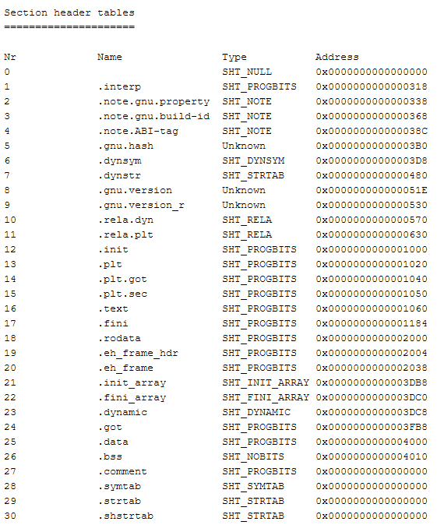

PIE
What is a position-independent executable?
http://www.sunshine2k.de/coding/javascript/onlineelfviewer/onlineelfviewer.html
COMP 520: Compilers – S. Ali

Slide 126
PIE
Every section (and segment) is just sequentially laid out in the file.
Linux realizes this, and loads sections at whatever memory address is convenient for it.
COMP 520: Compilers – S. Ali

Slide 127
PIE
This is useful for loading shared objects into another executable.
COMP 520: Compilers – S. Ali

Slide 128
PIE
This is useful for loading shared objects into another executable.
Downside: we won’t easily know where sections are in memory.
COMP 520: Compilers – S. Ali

Slide 129

What is helpful in PIE?
Note, you must have a loaded readable SEGMENT that contains the program headers (data on the segments)
It is helpful to have a section called .shstrtab
COMP 520: Compilers – S. Ali

Slide 130
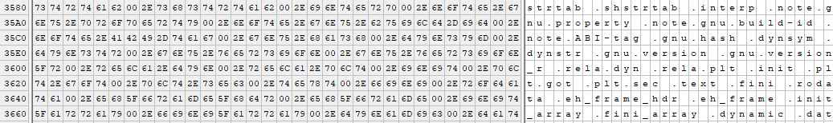
SHSTRTAB
This section is just a list of names
COMP 520: Compilers – S. Ali

Slide 131
ELF Generation
Fill out the TODO parts in the ELFMaker class
Once this is done, your code will be generating executable files
COMP 520: Compilers – S. Ali

Slide 132
Code Testing
COMP 520: Compilers – S. Ali

Slide 133
Compile some test file locally
Assume you are in the folder where “bin” contains your class files (compiled Compiler)
java –cp bin miniJava.Compiler ../my/test/file.java
COMP 520: Compilers – S. Ali

Slide 134
Compile some test file locally
Assume you are in the folder where “bin” contains your class files (compiled Compiler)
java –cp bin miniJava.Compiler ../my/test/file.java
This will output your “a.out” file.
COMP 520: Compilers – S. Ali

Slide 135
SSH to a server I set up
ssh comp520@home.digital-haze.org -p 52025
Username: comp520
Password: comp520
COMP 520: Compilers – S. Ali

Slide 136
SSH to a server I set up
ssh comp520@home.digital-haze.org -p 52025
Username: comp520
Password: comp520
Create a folder for yourself with your onyen:
mkdir swali
COMP 520: Compilers – S. Ali

Slide 137
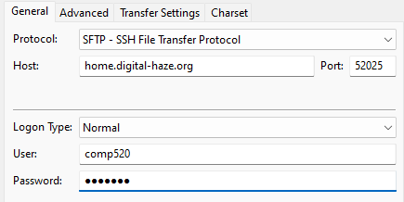
Use FileZilla (or any other method)
Connect to the server:
COMP 520: Compilers – S. Ali

Slide 138
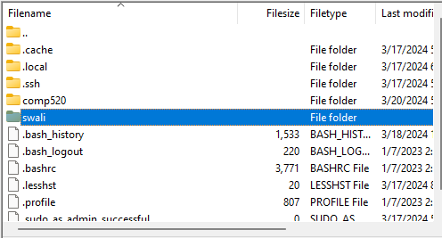
Enter your folder
Double Click
COMP 520: Compilers – S. Ali

Slide 139
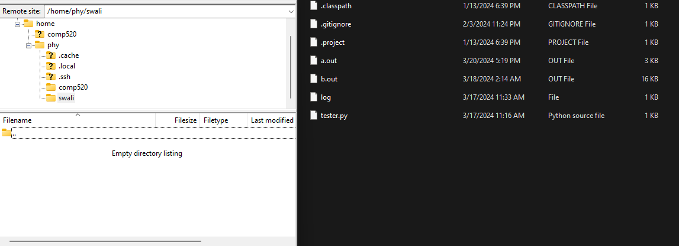
Drag and drop
COMP 520: Compilers – S. Ali

Slide 140
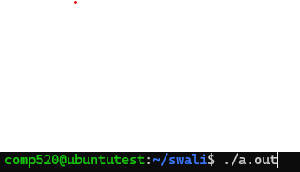
Run your a.out file
Make sure the output matches what you were expecting.
COMP 520: Compilers – S. Ali

Slide 141
End

Slide 142
COMP 520: Compilers – S. Ali

Slide 143
COMP 520: Compilers – S. Ali

Slide 144
COMP 520: Compilers – S. Ali

Slide 145
COMP 520: Compilers – S. Ali

